Slide 1
Microsoft Teams – Authentication and Single Sign-on (SSO) with tabs & bots
Single sign-on (SSO) with Microsoft Teams bots

Slide 2

Overview
Understand the SSO authentication flow
Configure the Azure AD application for SSO with bots
Configure the bot's OAuth connection settings

Slide 3
Understanding SSO in Microsoft Teams bots

Slide 4
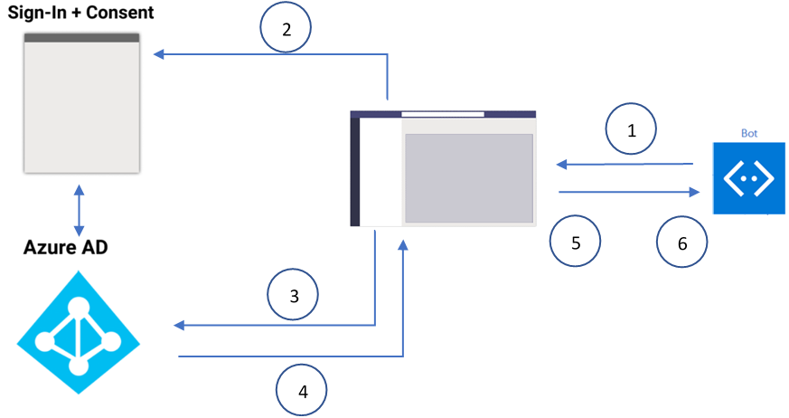
Understanding SSO in bots
Notes:
1. The bot sends a message with an OAuthCard that contains the `tokenExchangeResource` property. It tells Microsoft Teams to obtain an authentication token for the bot application. The user receives messages at all the active user endpoints.
2. If the current user is using your bot application for the first time, a request prompt is displayed, requesting the user to do one of the following:
3. Microsoft Teams requests the bot application token from the Azure AD endpoint for the current user.
4. Azure AD sends the bot application token to the Microsoft Teams application.
5. Microsoft Teams sends the token to the bot as part of the value object returned by the invoke activity with the name **sign-in/tokenExchange**.
6. The parsed token in the bot application provides the required information, such as the user's email address.

Slide 5
Configure the Azure AD app for SSO with bots
Azure AD app requirements match those for an app used in tab SSO, with a few differences
Redirect URI should point to the Bot Framework token endpoint
https://token.botframework.com/.auth/web/redirect
Expose API: Application ID URI should be prefixed with botid-, not a domain where the tab is hosted
api://botid-023adcaa-4fef-4a4d-a94a-0cde3a0c5b31

Slide 6
Azure Bot Framework registration & SSO
Bots registered with the Azure Bot Framework can be used with Microsoft Teams
To support SSO, add an OAuth connection setting in the bot’s properties
Associate the bot OAuth settings with the registered Azure AD app
Set the Token Exchange URL to the Application ID URI
Set Tenant ID to common
Set Scopes to a space-delimited list of permissions the bot needs

Slide 7
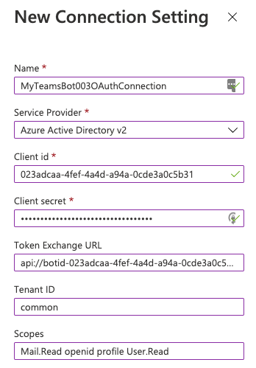
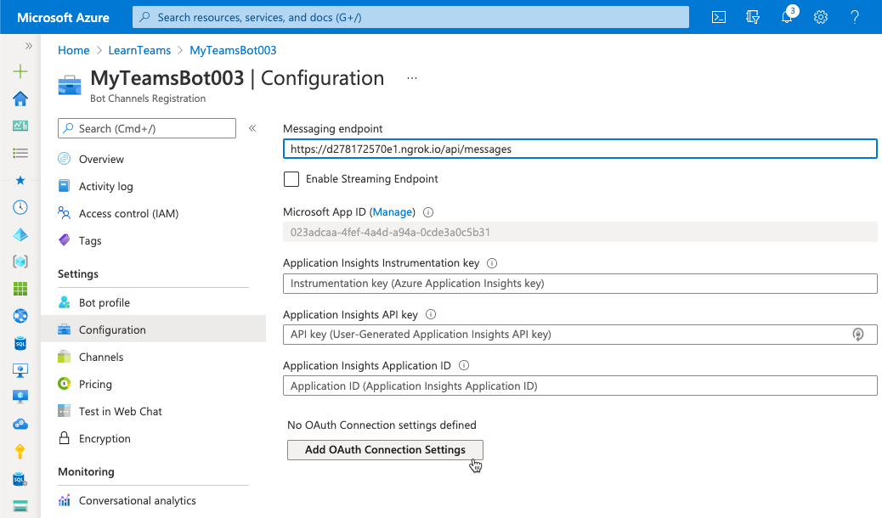
Bot OAuth connection settings

Slide 8
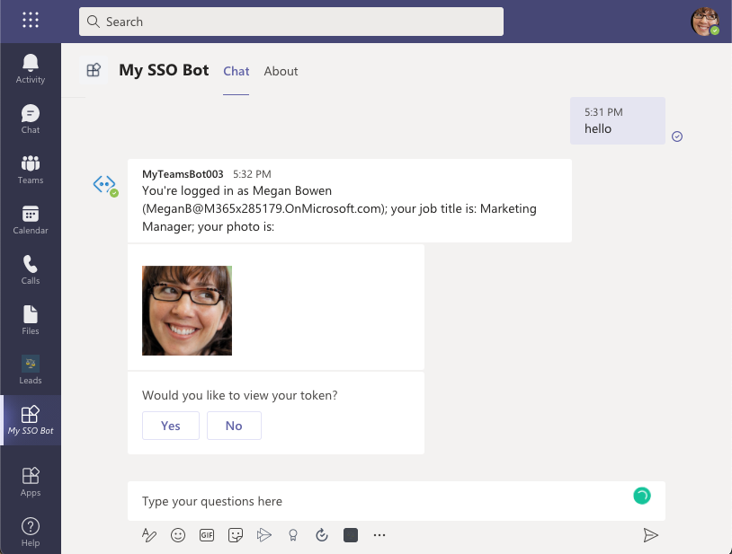
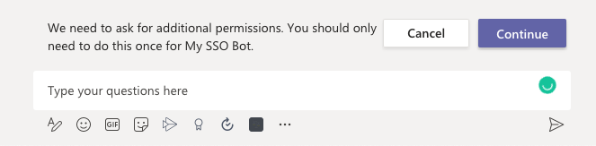
Microsoft Teams SSO bot end user experience
When a user activates the bot the first time, it will prompt for consent

Slide 9
When building bots that require authentication, consider dialogs
Provide state-based model to manage long-running conversation with user
Nature of sequential conversation that depends on authentication makes dialogs well suited for the scenario
Simply the sequential steps of:
Signing in
Interacting with the user, secured resources, and both authorization
Signing out
Learn more:
Bot Framework – Dialogs
https://docs.microsoft.com/composer/concept-dialog
Bot Framework SDK – Dialogs library
https://docs.microsoft.com/azure/bot-service/bot-builder-concept-dialog

Slide 10
Coding an SSO bot for Microsoft Teams
// using the WaterfallDialog approach
constructor() {
this.addDialog(new WaterfallDialog(MAIN_WATERFALL_DIALOG, [
this.promptStep.bind(this),
this.loginStep.bind(this)
]));
}
// prompt the user to sing in if necessary, otherwise obtain token
async promptStep(stepContext) {
return await stepContext.beginDialog(OAUTH_PROMPT);
}

Slide 11
Coding an SSO bot for Microsoft Teams
async loginStep(stepContext) {
const tokenResponse = stepContext.result;
if (!tokenResponse || !tokenResponse.token) {
await stepContext.context.sendActivity('Login unsuccessful - try again.');
} else {
const microsoftGraphClient = new MicrosoftGraphClient(tokenResponse.token);
// get user's basic profile information
const me = await microsoftGraphClient.getMe();
// respond to Microsoft Teams with an activity message
await stepContext.context.sendActivity(
`You're ${me.displayName} (${me.userPrincipalName})`);
}
return await stepContext.endDialog();
}

Slide 12
Demo

Slide 13

Summary
Understand the SSO authentication flow
Configure the Azure AD application for SSO with bots
Configure the bot's OAuth connection settings

Slide 14
Thank you.

